Slide 1
Lab 3
static modifier, this keyword, Control Statemens and Operators.
CS F213
Object Oriented Programming

Slide 2
Agenda
static modifier
this keyword
Control Statements
Operators.
Assignment Problems to be discussed for submission (on Jdoodle)
Extra Practise Problems
To be done outside lab hours

Slide 3
static modifier
In general, a class member must be accessed only by using an object of its class.
However, there will be times when you will want to define a class member that will be used independently of any object of that class.
To create such a member (variable or method), precede its declaration with the keyword static.
When a member is declared static, it can be accessed before any objects of its class are created, and without reference to any object.

Slide 4
Declaring Instance Variables as static
Instance variables declared as static are global variables.
When objects of its class are declared, all instances of the class share the same static variable.
Advantages of Static variable:
It makes your program memory efficient (i.e., it saves memory).

Slide 5
Methods declared as static
Methods declared as static have several restrictions that have been mentioned below:
They can only directly call other static methods of their class.
They can only directly access static variables of their class.
They cannot refer to this or super in any way. (The keyword super relates to inheritance and will be explained in the upcoming sessions.)

Slide 6
static block
It can be used to initialize static variables.
A static block that gets executed only once when the class is first loaded.
Syntax for static block:
static{
// initialize static variables
}

Slide 7
Example program with a static block

Slide 8
Execution order of static statements of a Class
As soon as the UseStatic class is loaded, all of the static statements are run.
First, a is set to 3, then the static block executes, which prints a message and then initializes b to a*4 or 12.
Then main( ) is called, which calls meth( ), passing 42 to x.

Slide 9
Accessing static variables and methods Outside the class
Both static variables and methods can be accessed outside the class without using any object.
To do so, we need to specify the name of the corresponding class followed by the dot operator.
for example, classname.methodname()
Note: classname is the name of the class in which the static method is
declared.
Similarly, A static variable can be accessed in the same way—by use of the dot operator on the name of the class.

Slide 10
Example program of accessing static variables and methods from outside the class

Slide 11
this keyword
Keyword this is a reference variable in Java that refers to the current object.
There are various usages of this keyword that are as follows:
It can be used to refer instance variable of current class.
It can be used to invoke or initiate current class constructor.
It can be passed as an argument in the method call.
It can be passed as argument in the constructor call.
It can be used to return the current class instance.

Slide 12
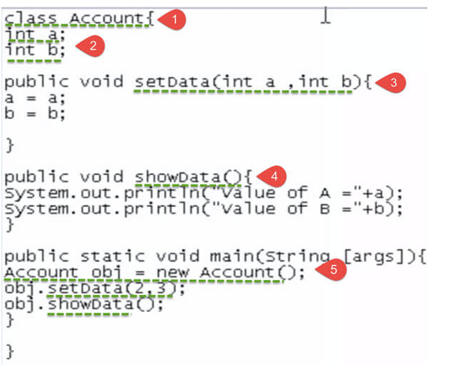
The expected output for A and B
should be initialized to the values 2
and 3 respectively.
But the value it would give is 0 for both.
In the method Set data,
the arguments are declared as a and
b, while the instance variables
are also named as a and b

Slide 13
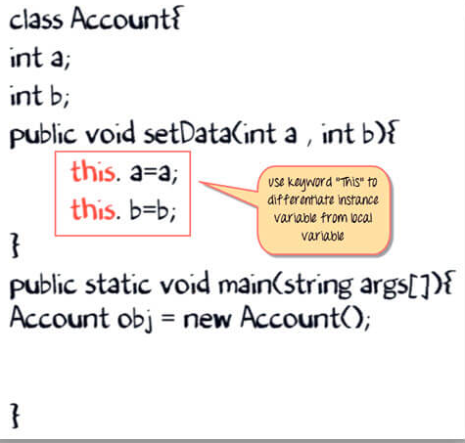
Solution for the mentioned problem is this keyword
During code execution when an object calls the method 'setdata'. The keyword 'this' is replaced by the object handler "obj."
Now, the 'a' on the left-hand side is an Instance variable.
Whereas the 'a' on right-hand side is a local variable. With the help of this keyword, we can get the expected output.

Slide 14
Control Statements
if
if-else
Nested ifs
if-else-if ladder
switch case
break
continue
return
Note: Refer to Complete Reference Java Text book for detailed information.

Slide 15
Operators
We can divide all the Java operators into the following groups:
Arithmetic Operators (+, -, *, /, %, ++, --)
Relational Operators (==, !=, >, >=, <, <=)
Logical Operators (&&, ||, !)
Bitwise Operators (&, |, ^, ~, <<,>>, >>> )
Assignment Operators (=, +=, -=, *=, /=, %=, <<=,>>=, &=, ^=, |= )

Slide 16
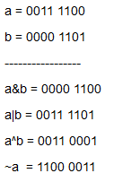
Bitwise Operations
Java defines several bitwise operators, which can be applied to the integer types, long, int, short, char, and byte.
Bitwise operator works on bits and performs bit-by-bit operation.
Assume if a = 60 and b = 13; now in binary format they will be as follows:

